Slide 1
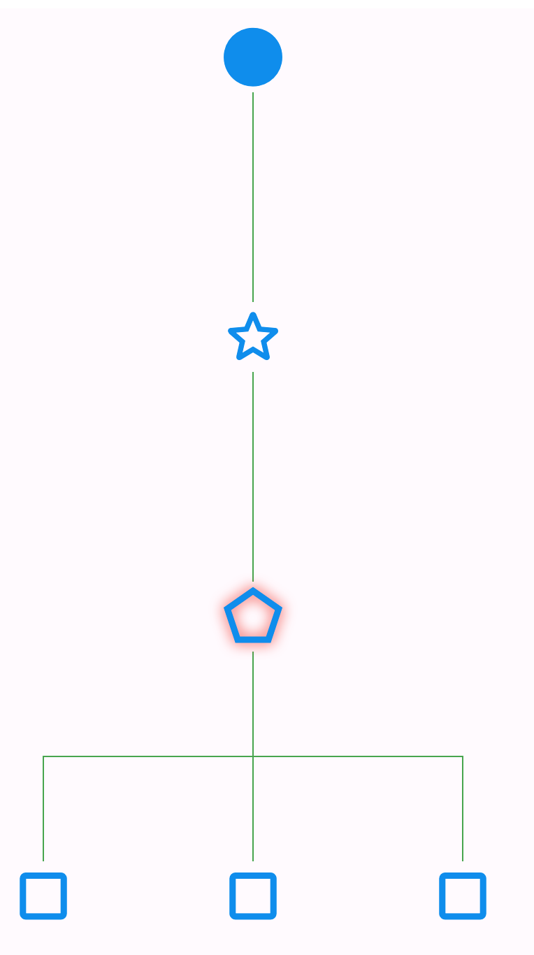
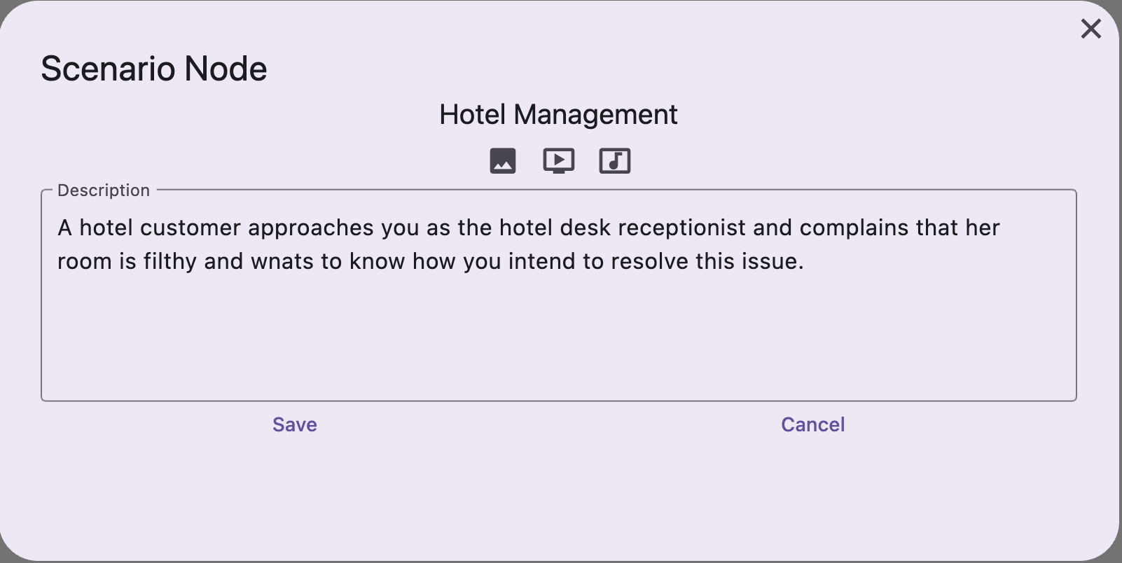
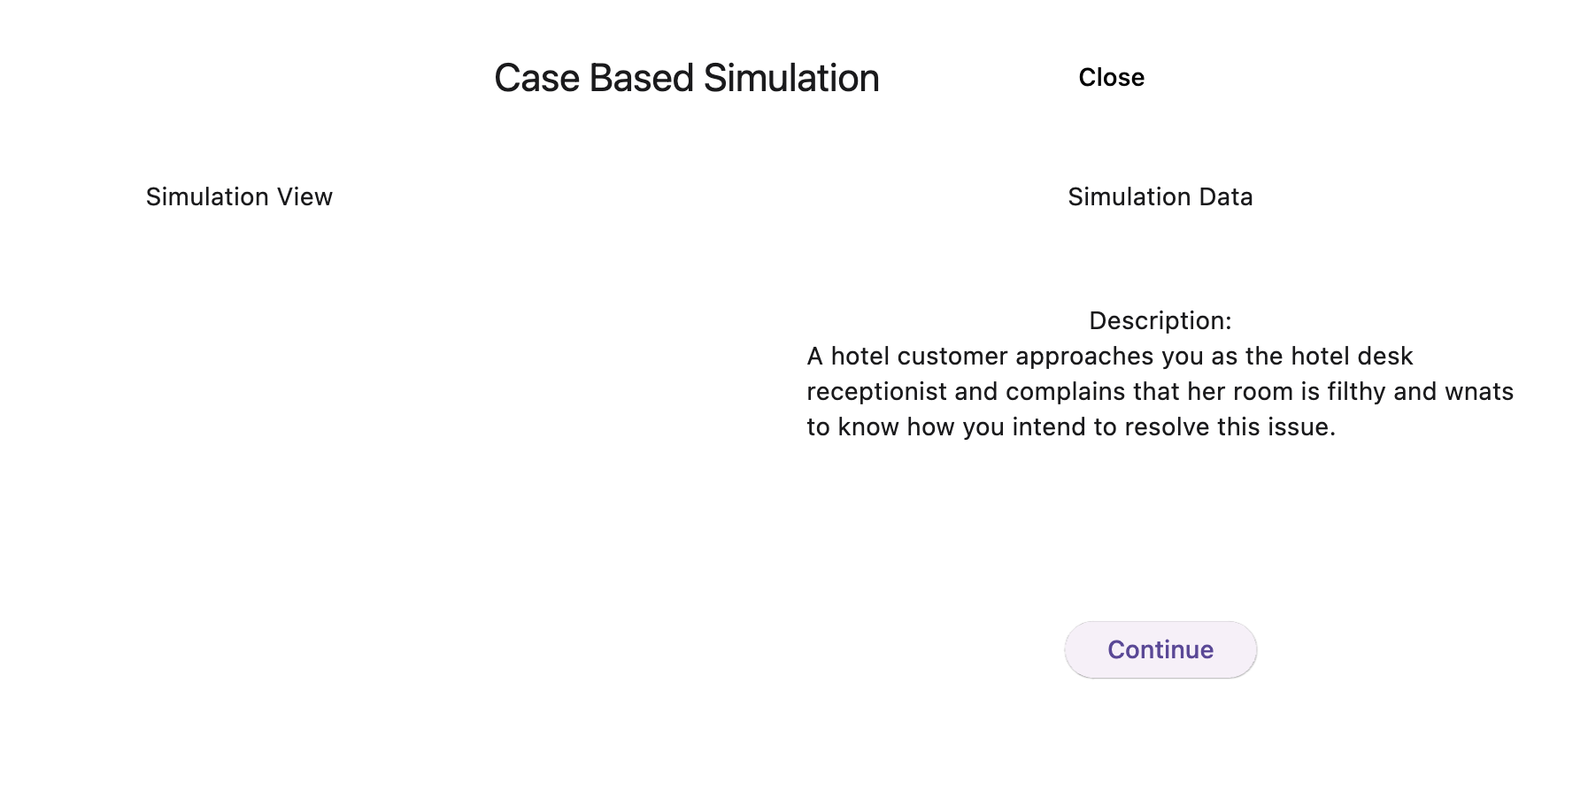
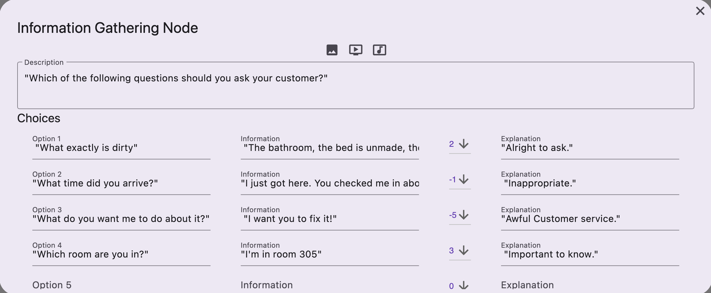
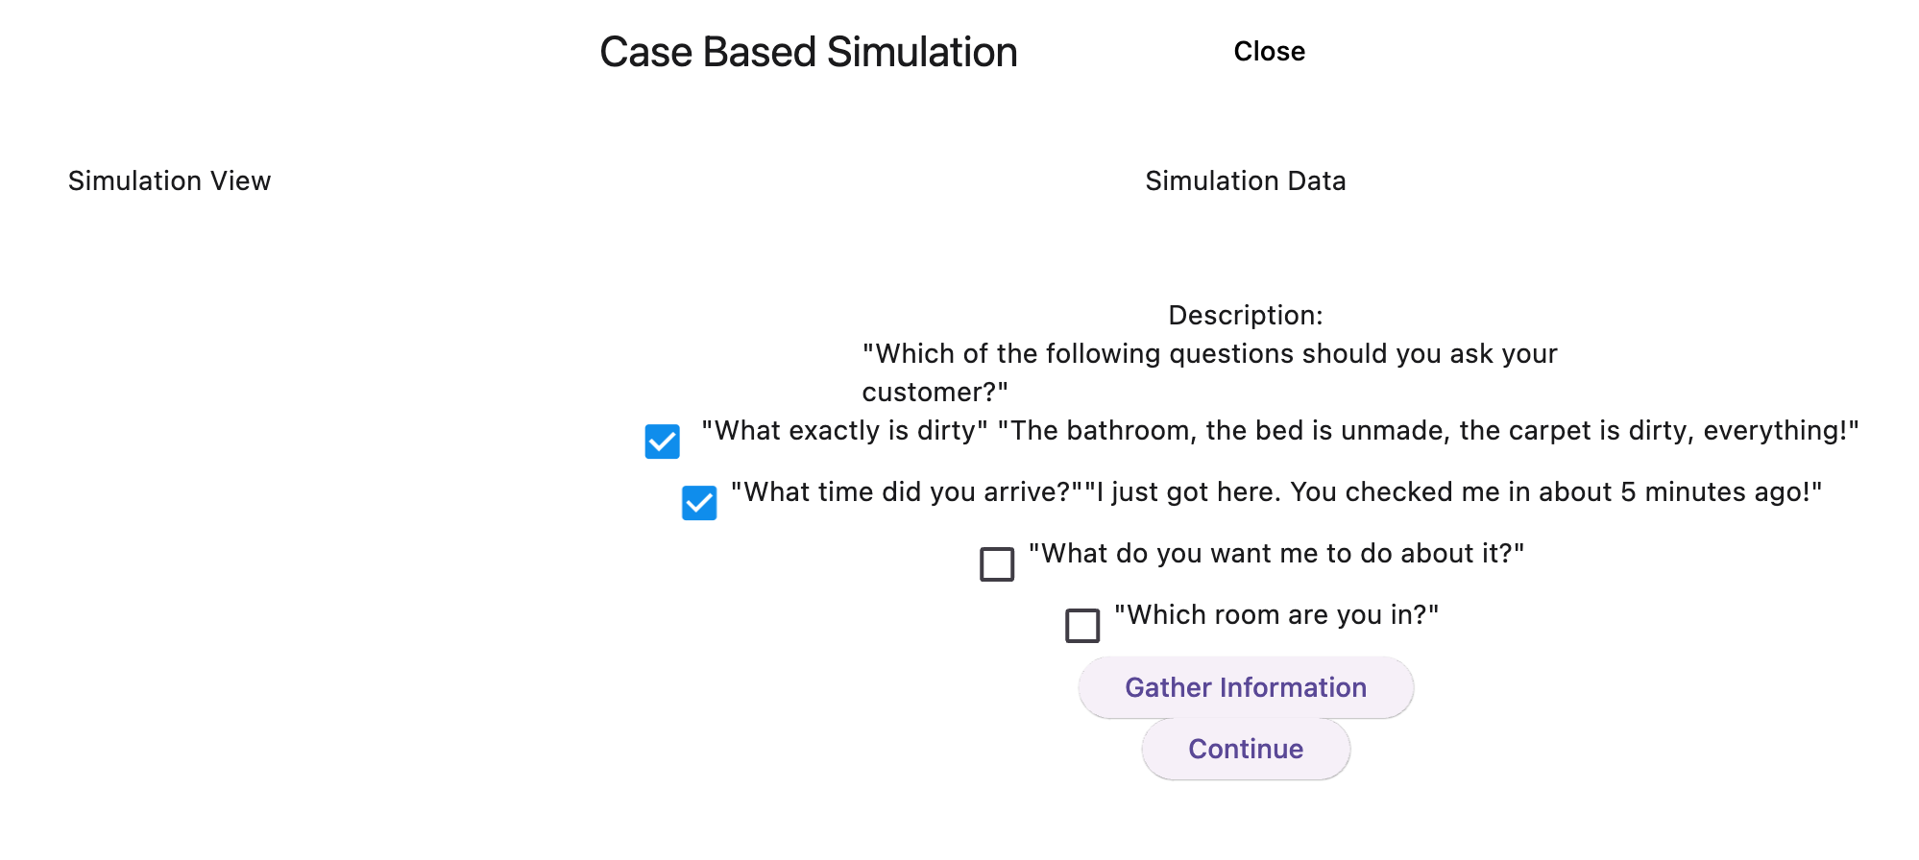
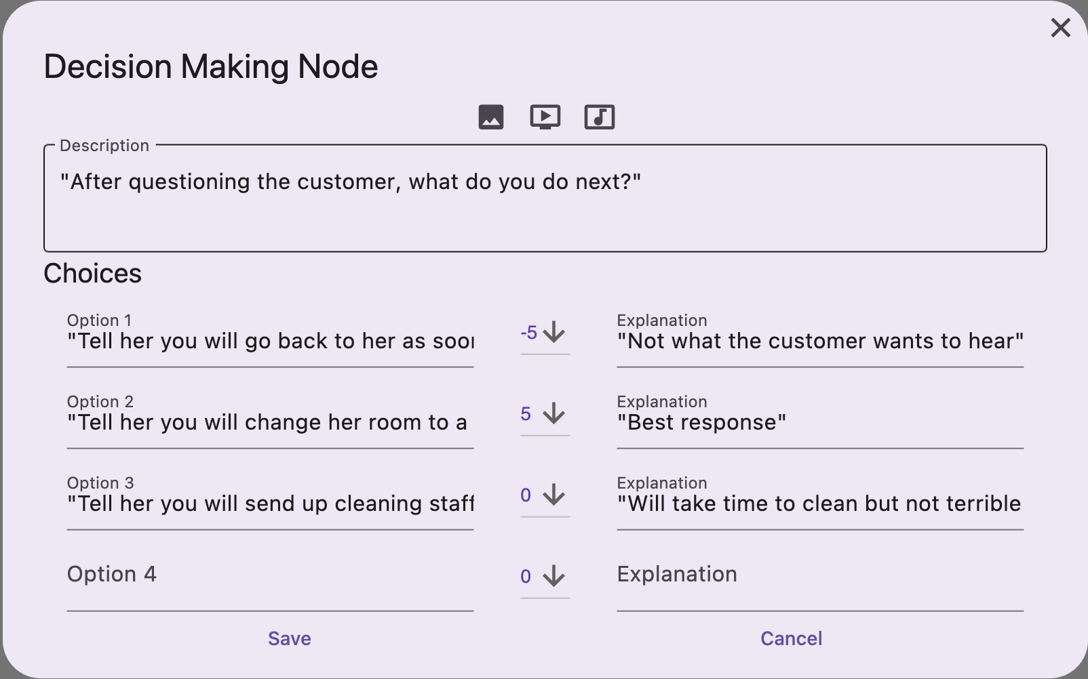
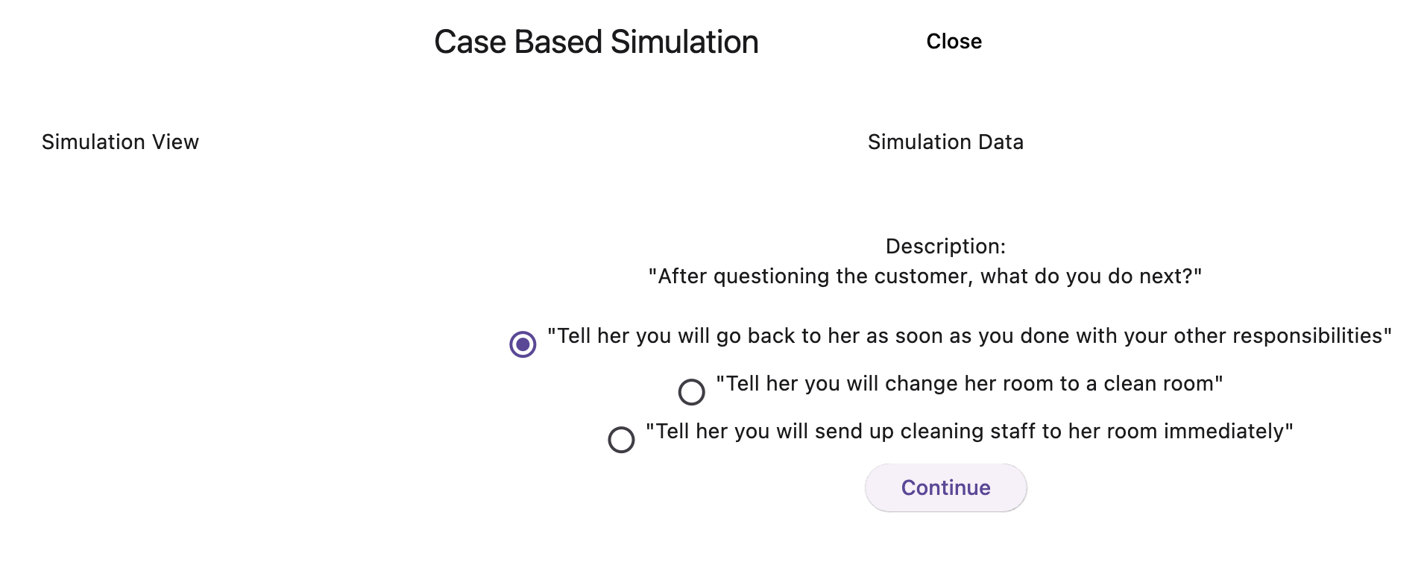
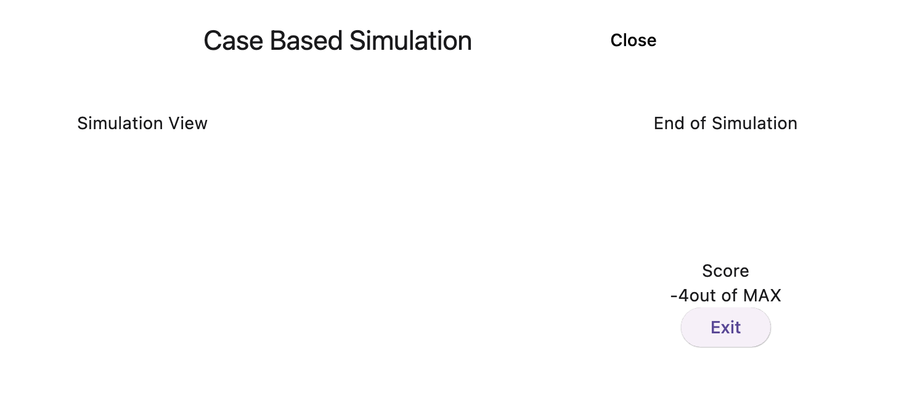

Case-Based Simulation Builder
Jacob Schmitt, Timothy Mai, Austyn Mancini, Kuan Liu, Nathaniel Hector, Sean Jerzewski
Faculty Advisors: Neil Toporski, Jack Myers
Introduction
Many industries, such as healthcare, emergency response, and customer services, require realistic training scenarios for professionals to develop their skills. Case-Based Simulation Builder would provide a platform for creating immersive and interactive training modules. Case-Based Simulation Builder is a web application that enables developers to design and construct authentic simulated environments. These environments allow users to access and interact with simulations through four primary user interventions or "nodes": scenario, information-gathering, decision-making, and end. Users begin with a problem set, or scenario node, and progress through the simulation's decision tree, gathering data and making decisions based on environmental or situational conditions. This dynamic process leads users through a series of multiple possible branched pathways. Finally, users complete the simulation at the end node, where their judgments regarding their interaction with the simulation are evaluated. The primary purpose of the Case-Based Simulation Builder is to provide developers with a web-based tool for building, editing, saving, or deleting case-based simulations, which users can then access and engage with.
Tree View
Developer View
User View
The application enables the visualization of the tree of nodes, ensuring clarity and organization within the simulation interface. Additionally, we have explored how the tree handles changes through node addition and deletion, ensuring robustness and adaptability in response to developer interactions. During our development process, we encountered challenges in seamlessly repopulating the tree from the database when a developer reopens a simulation. The order in which data is stored in the database doesn't directly match how the tree is structured. Therefore, our solution involved sorting the nodes into a graph when we pull them from the database to ensure they are in the correct structure to reflect the simulation the developer created.
Moreover, we have ensured that the nodes displayed in the tree view are clickable, allowing users to effortlessly explore different branches and pathways within the simulation. The tree display package supports 10 levels of depth and multiple branches, accommodating complex decision-making scenarios and diverse learning trajectories.
SCENARIO Node:
The Scenario node marks the beginning of the simulation journey, presenting users with the problem set or environmental scenario they must navigate. It introduces users to the core challenges they will encounter and sets the stage for their decision-making process. Each simulation has only one Scenario node, serving as the initial point of engagement for users.
Information Gathering (IG) Node:
The Information Gathering node enables users to collect relevant data to better understand the current conditions of the simulation. Users can access and review content from the simulation, helping them make informed decisions and assessments. There can be multiple Information Gathering node within each simulation, facilitating focused data gathering and analysis.
Use Case
Decision-Making (DM) Node:
The Decision-Making node allows users to make choices or decisions that influence the progression of the simulation. Users are presented with multiple options or pathways, each branching out from the Decision-Making node. While there can be multiple Decision-Making nodes within a simulation, the number of child nodes or decisions is limited to four, ensuring clarity and manageability in decision-making processes.
Medical Simulation Training
Scenario Node:
The Scenario node introduces medical students or healthcare professionals to a simulated patient case. For example, it could present a scenario where a patient arrives with chest pain and shortness of breath.
Information Gathering (IG) Node:
The IG node allows users to gather relevant patient data, such as vital signs, medical history, and symptoms. Users can review lab results, imaging studies, and other diagnostic information to better understand the patient's condition.
Decision-Making (DM) Node:
The DM node enables users to make critical decisions regarding patient care. They may need to choose between different treatment options, prioritize interventions, or decide whether to consult with specialists.
End Node:
The End node marks the conclusion of the simulation, where users' decisions and actions are evaluated. It provides feedback on their diagnostic accuracy, treatment efficacy, and adherence to clinical guidelines.
Real-Life Use Case
In a medical training program, students could use the Case-Based Simulation Builder to practice diagnosing and treating various medical conditions.
The platform would allow students to work through realistic patient cases: gathering information, making decisions, and observing the outcomes of their actions.
After completing the simulation, students will receive feedback on their performance, helping them identify areas for improvement and reinforcing key concepts in patient care.
End Node:
This node marks the completion of the simulation. It displays the result, including the user's score and an explanation of their performance. Every branching path created from a Decision-Making node results in a unique end node which provides an analysis of the specific path to reach that conclusion.
Future Development
In future iterations of the Case-Based Simulation Builder, several enhancements are planned to further enrich the user experience and expand the application's capabilities. One key area of development involves the introduction of user accounts with monetization features, requiring users to set up billing plans for access. This not only ensures a return on investment, but also fosters a sustainable business model. Additionally, account security measures, including password and username protection, will safeguard user data and information. Furthermore, account retrieval options will provide a convenient way for users to recover lost credentials. Another proposed feature is the integration of simulation deadlines, encouraging timely completion of tasks. Time tracking will also be leveraged to influence user scores, with faster completion leading to higher ratings. Moreover, future versions will broaden media input options, including 360 images, animations, and gifs, to enhance simulation immersion. Finally, expanding the size and complexity of simulation trees will offer users deeper and more diverse decision-making scenarios, further improving the learning experience. These developments aim to solidify the Case-Based Simulation Builder as a comprehensive and dynamic platform for interactive learning and training simulations.

